Slide 1

Introduction to the Classical Language Toolkit (CLTK)
Kyle P. Johnson, PhD
kyle@kyle-p-johnson.com
http://cltk.org
NYU, Classics Dept.
Nov 17, 2015

Slide 2
The CLTK’s goals …
Notes:
Why the need for the CLTK? To bring state-of-the-art NLP to the study of Ancient World.

Slide 3
The CLTK’s goals …
Low: Good datasets for advanced NLP of Ancient Greek and Latin languages

Slide 4
The CLTK’s goals …
Low: Good libraries for advanced NLP of Ancient Greek and Latin languages
Medium: Quantified Classics

Slide 5
The CLTK’s goals …
Low: Good libraries for advanced NLP of Ancient Greek and Latin languages
Medium: Quantified Classics
High: Framework for an integrated study of ancient literature

Slide 6
Some basic terms
Python: A programming language known for its easy-to-read syntax and general friendliness
Notes:
A library is more like a book

Slide 7
Some basic terms
Python: A programming language known for its easy-to-read syntax and general friendliness
NLP: Natural language processing
Notes:
A library is more like a book

Slide 8
Some basic terms
Python: A programming language known for its easy-to-read syntax and general friendliness
NLP: Natural language processing
Package or “library”: Collection of software for a particular set of tasks
Notes:
A library is more like a book

Slide 9
Some basic terms
Python: A programming language known for its easy-to-read syntax and general friendliness
NLP: Natural language processing
Package or “library”: Collection of software for a particular set of tasks
NLTK: A prominent NLP package for the Python language
Notes:
A library is more like a book

Slide 10
Some basic terms
Python: A programming language known for its easy-to-read syntax and general friendliness
NLP: Natural language processing
Package or “library”: Collection of software for a particular set of tasks
NLTK: A prominent NLP package for the Python language
Git: Software for distributed software development
Notes:
A library is more like a book

Slide 11
Some basic terms
Python: A programming language known for its easy-to-read syntax and general friendliness
NLP: Natural language processing
Package or “library”: Collection of software for a particular set of tasks
NLTK: A prominent NLP package for the Python language
Git: Software for distributed software development
GitHub: A website which makes Git easy
Notes:
A library is more like a book

Slide 12
Some basic terms
Python: A programming language known for its easy-to-read syntax and general friendliness
NLP: Natural language processing
Package or “library”: Collection of software for a particular set of tasks
NLTK: A prominent NLP package for the Python language
Git: Software for distributed software development
GitHub: A website which makes Git easy
Jupyter (formerly IPython): “Scientific notebooks”, an easy way to share code
Notes:
A library is more like a book

Slide 13
Technical organization: Repositories

Slide 14
Technical organization: Repositories
Notes:
Distributed!

Slide 15
Technical organization: Core vs. Data
CLTK Core software
Led by programmers
Coordinates data processing
Downloads and installs data repositories

Slide 16
Technical organization: Core vs. Data
CLTK Core software
Led by programmers
Coordinates data processing
Downloads and installs data repositories
Linguistic data repositories
Led by language experts
Plaintext corpora
Trained models (for machine learning)
Dictionaries, word lists
Tagged texts (for part-of-speech, dependency grammar)

Slide 17
Personnel organization: Teams
CLTK organization on GitHub (forthcoming)
Admins
Contributors
Unaffiliated contributors

Slide 18
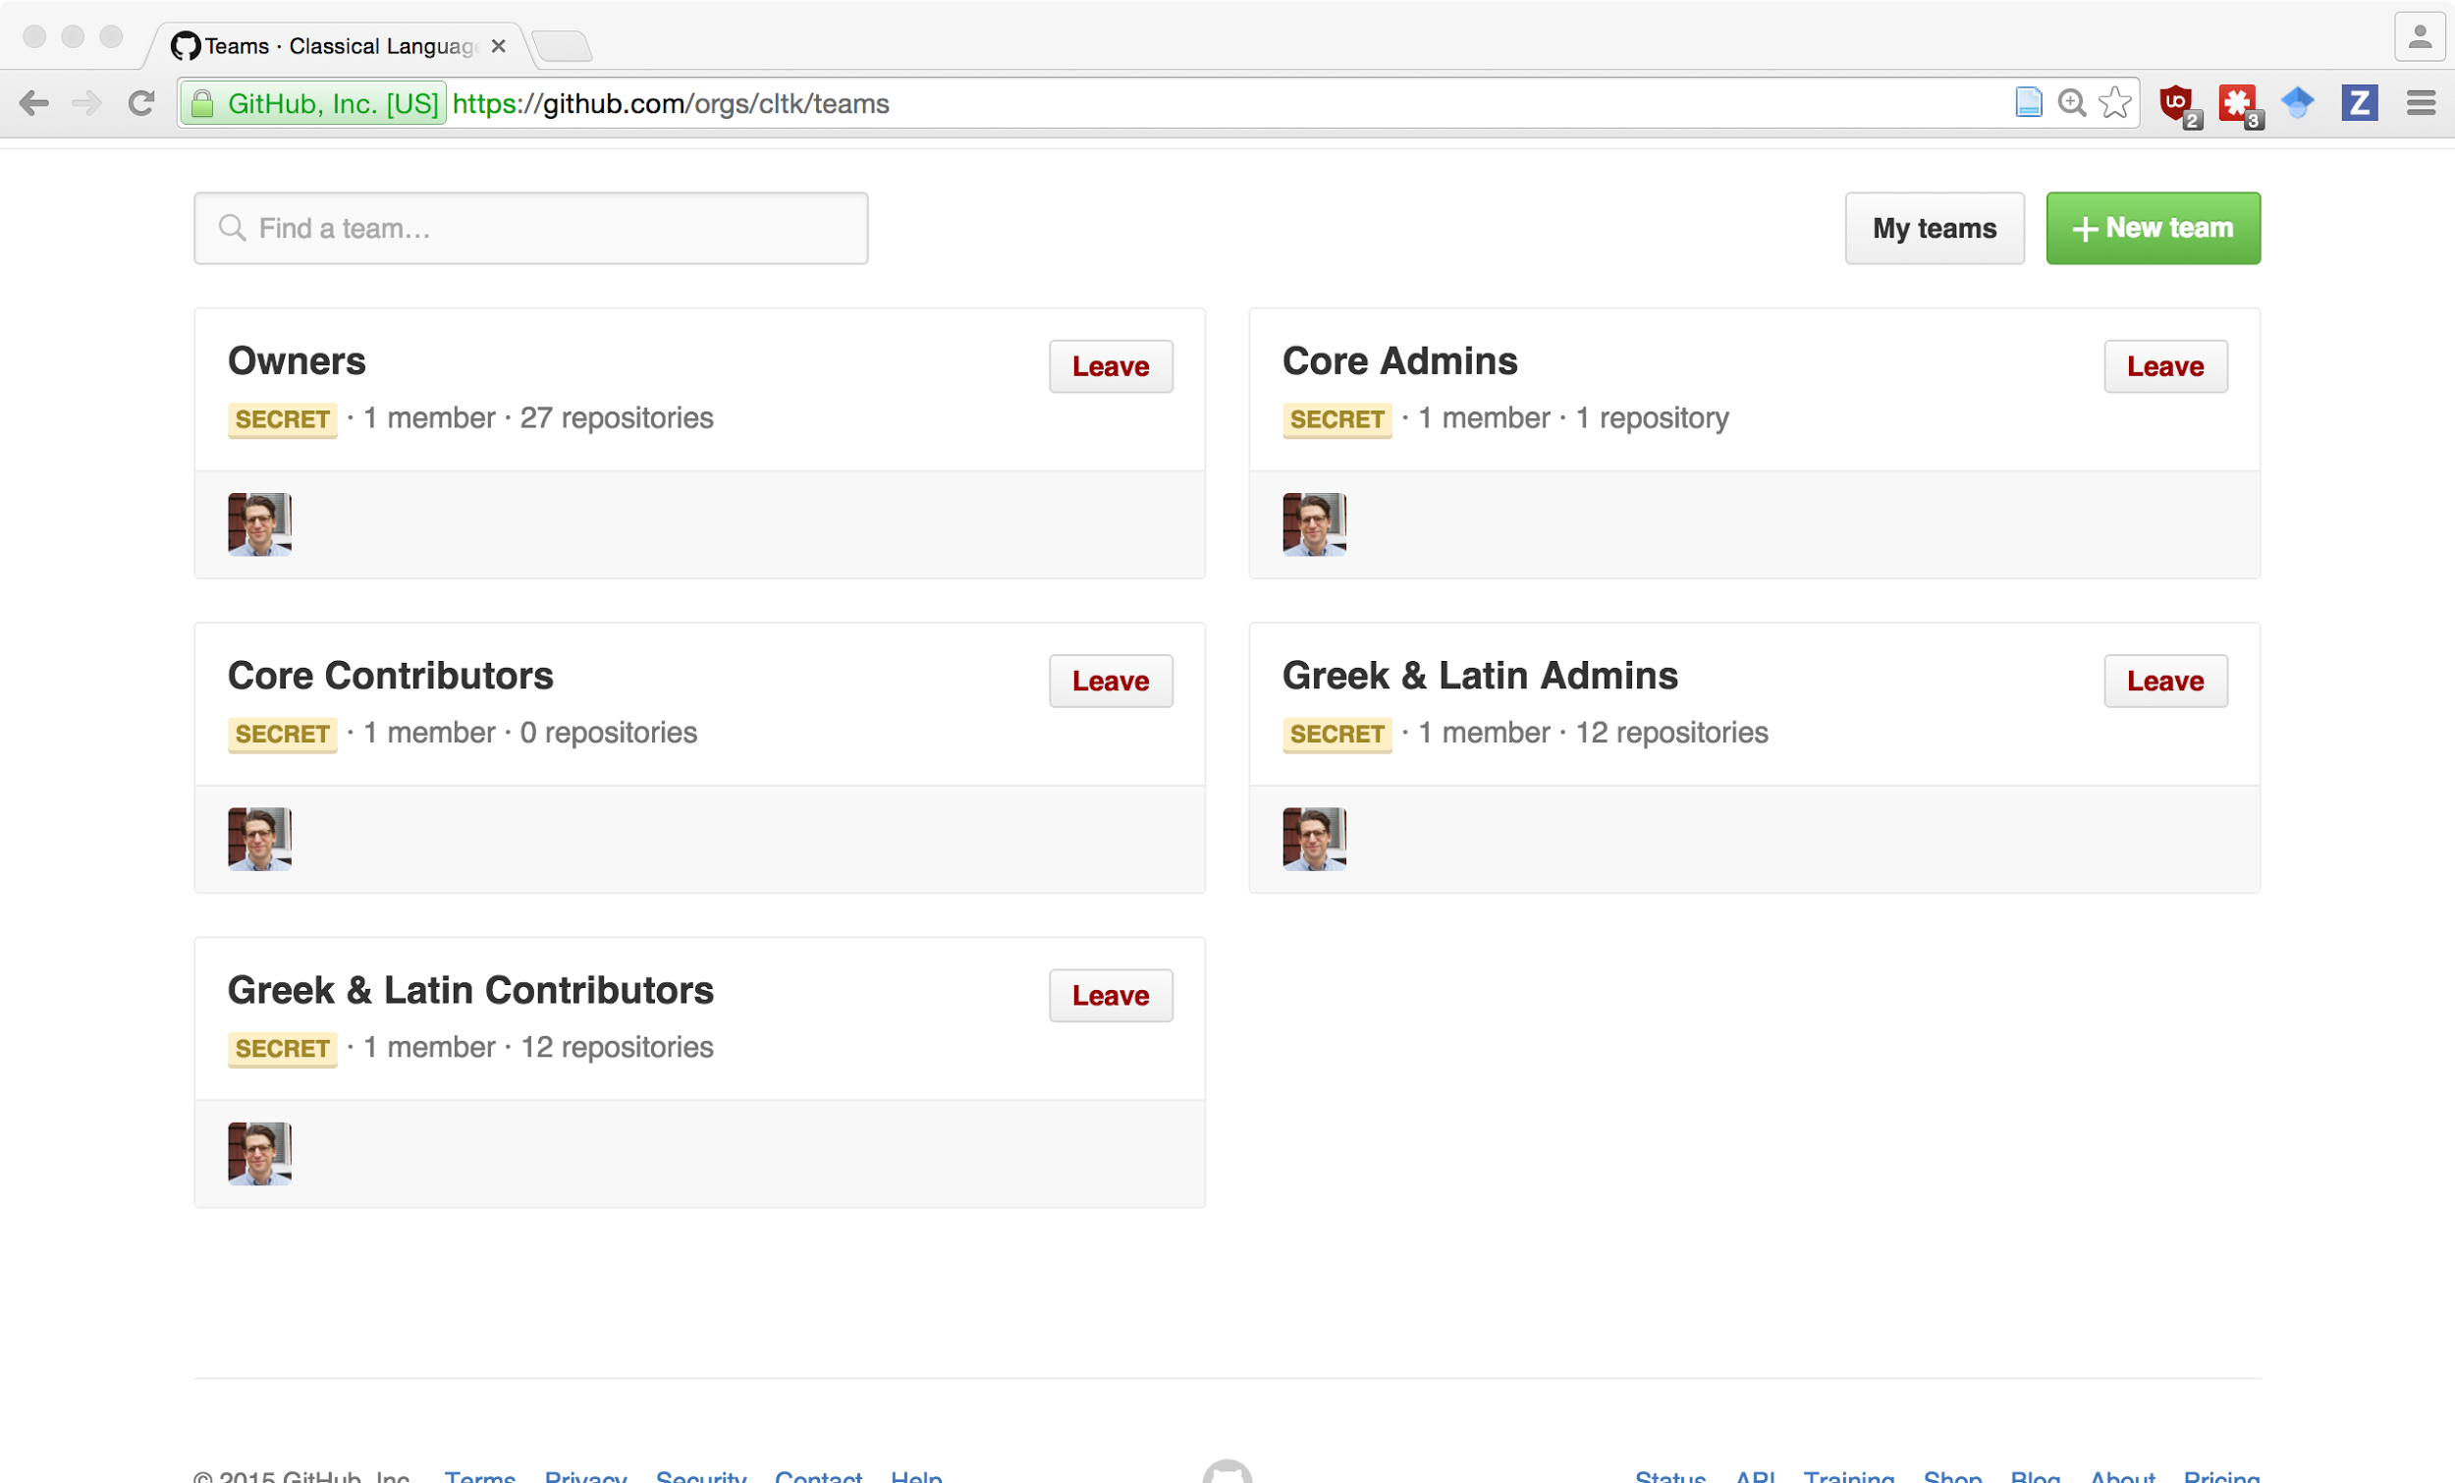
Personnel organization: Teams (cont'd.)
Notes:
Kinda lonely!

Slide 19
(Really quick) quickstart
Make virtualenv and download core
$ pyvenv venv
$ source venv/bin/activate
$ pip install cltk
Download and import corpora
$ python
>>> from cltk.corpus.utils.importer import CorpusImporter
>>> ci = CorpusImporter('greek')
>>> ci.list_corpora
['greek_software_tlgu', 'greek_text_perseus', 'phi7', 'tlg', 'greek_proper_names_cltk', 'greek_models_cltk', 'greek_treebank_perseus', 'greek_lexica_perseus', 'greek_training_set_sentence_cltk', 'greek_word2vec_cltk']
>>> ci.import_corpus('greek_text_perseus')

Slide 20
Setup for PHI and TLG corpora
PHI5, PHI7, and TLG_E
Not downloaded, but imported from local files
>>> ci.import_corpus('tlg', '~/Documents/corpora/TLG_E/')
Makes copy of corpus at ~/cltk_data/originals
Convert TLG from Beta Code into Unicode
>>> from cltk.corpus.greek.tlgu import TLGU
>>> t = TLGU()
>>> t.convert_corpus(corpus='tlg')
>>> t.convert_corpus(corpus='phi5')
Makes copy of corpus in ~cltk_data/greek/text/tlg or ~/cltk_data/latin/text/phi5

Slide 21
NLP for all languages
Concordance
Information retrieval
Plain and regex searching
Robust boolean search on the way
n-gram: 'Ut primum nocte discussa sol’
bigrams: ('ut', 'primum'), ('primum', 'nocte'), ('nocte', 'discussa'), ('discussa', 'sol')
trigrams: ('ut', 'primum', 'nocte'), ('primum', 'nocte', 'discussa'), ('nocte', 'discussa', 'sol')
5-grams: ('ut', 'primum', 'nocte', 'discussa', 'sol')
Word frequencies
simple count for a word
complete reports for a text
Word tokenization (via NLTK)

Slide 22
NLP for Greek and Latin
Text normalization
j → i, v → u (Latin)
Beta Code conversion (for legacy Greek texts)
TLG and PHI corpus specific (remove formatting)
Sentence tokenizer
Lemmatizer
Stemmer (Latin)
Word tokenizer, for enclitics (Latin)
Stopword filtering
Notes:
Word tokenizer by Patrick Burns; stemmer by Luke Hollis

Slide 23
NLP for Greek and Latin (cont'd.)
Named Entity Recognition (NER)
Part-of-speech (POS) tagger
From Perseus/Alphaeus treebank
Great work remaining to be done, convert their codes to others (Brill, PROIEL, etc)
# TODO! Dependency grammar tagger
Prosody scanner
Syllabifier (Greek)
TLG and PHI5 indices
File to author, genre to authors, date to authors, gender to authors, etc.
Word2Vec
Notes:
Prosody by Tyler Kirby; syllabifier by Luke Hollis

Slide 24
Beyond Greek and Latin
Chinese, Coptic, Pali, Tibetan
2.5 GB (!) of Chinese Buddhist texts
Corpus of Coptic texts
Pali Tipitaka
Tibetan POS tagged texts and a lexicon

Slide 25
Beyond Greek and Latin
Chinese, Coptic, Pali, Tibetan
2.5 GB (!) of Chinese Buddhist texts
Corpus of Coptic texts
Pali Tipitaka
POS tagged texts and a lexicon
Growth areas
Many more ancient resources to be discovered, normalized, and incorporated into the CLTK ecosystem.
Great opportunities for outreach
To departments, disciplines, countries, and traditions
See List of Classical languages
Follow the Greek and Latin code patterns to add support any language!

Slide 26
Citation
Developed by many talented contributors!
BibTex
@Misc{johnson2014, author = {Kyle P. Johnson et al.}, title = {CLTK: The Classical Language Toolkit}, howpublished = {\url{https://github.com/kylepjohnson/cltk}}, note = {{DOI} 10.5281/zenodo.<current_release_id>}, year = {2014--2015}, }
Chicago author-date
Kyle P. Johnson et al.. (2014-2015). CLTK: The Classical Language Toolkit. DOI 10.5281/zenodo.<current_release_id>
Note: Current DOI release id available at: https://github.com/kylepjohnson/cltk

Slide 27
Resources
This lecture’s code
Core software: https://github.com/cltk/cltk
Bug tracking: https://github.com/cltk/cltk/issues
Beginners’ issues labeled easy
Project repositories: https://github.com/cltk
Docs: http://docs.cltk.org
Installation: http://docs.cltk.org/en/latest/installation.html
Python + Command line basics
Intro to the command line: http://blog.teamtreehouse.com/introduction-to-the-mac-os-x-command-line
Python installation: https://www.python.org/downloads/ (choose 3.5)
Good self-paced Python lessons: http://learnpythonthehardway.org/

